Slide 1

My Linear Relationships Interactive Notebook
Name
Class
Teacher
Semester 2
Term 4
1

Slide 2

Interactive Notebooks!
Cover Page
Contents Page
Glossary
24/7/30
EQ
Questions
Notes
Summaries
Work page
Presentation!!!
Your book, your responsibility!

Slide 3
Contents
Glossary or Formula Page
Page
Date
Description
For example
Linear: ___________
Origin: ___________
Coordinates: __________
2
3

Slide 4

24
7
30
Tasks
24
7
30
Essential Question
Complete the tasks on this side (left) of your page
You should be ticking these off!
Questions
Notes
Write your notes on this side (right) of your page
Summary
Have YOU been doing your summaries?
Your book, your responsibility!

Slide 5
25c Pyramid
In this AVID activity, split up into pairs and decide who is ‘A’ and who is ‘B’
Person A needs to face towards the board and Person B needs to face away
3 words will be displayed on the board. Person A needs to get Person B to say that word (by explaining it)
Person A cannot use the word itself or describing how it’s spelt (you can’t say it starts with the letter…)
Person B cannot peak!!!
As soon as the person has got all 3 words (you can do them in any order), both people need to sit down

Slide 6
First set of words
Car
Pen
Variable
Hint: Letters that represent unknown numbers

Slide 7
Second set of words
Duck
Calculator
Equation
Hint: Has an equal sign and variables

Slide 8
Third set of words
Perth
Interactive Notebook
Graph
Hint: How we display data

Slide 9
Fourth set of words
Spoon
Ruler
Straight Line
Hint: What we use a ruler for, not curved

Slide 10
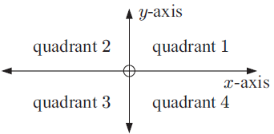
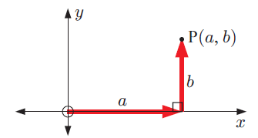
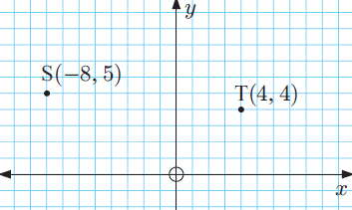
24
7
30
Topic: Linear Relationships
Date
EQ – How do I plot points on a Cartesian Plane?
What is the Cartesian Plane?
The Cartesian Plane has 4 quadrants, split up by the ___-axis (horizontal or across) and the ___-axis (vertical).
The centre, where the axes meet, is called the _______.
A point is described by 2 values or coordinates (x, y).
x = the horizontal distance from the origin
y = the vertical distance from the origin
Quadrant 1: x and y are both positive
Quadrant 2: x is _________ and y is __________
Quadrant 3: x is _________ and y is __________
Quadrant 4: x and y are both __________
For example S = (-8, 5) T = (4,4)
U = _____ V = ____
How is point described/written?
(x, y )
y
x
V
U

Slide 11
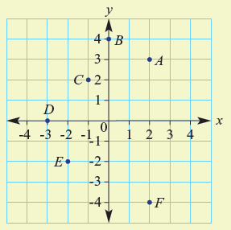

Let’s try one together
Write down the coordinates for A-F

Slide 12

Do you understand?
Notes:
Check for Understanding

Slide 13
Your Turn
Turn to page 215 in your Dwyer Book and complete Exercise 16.2
Left Hand Side

